Slide 1
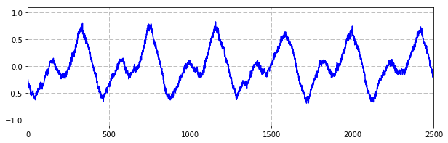
Predict
Long Short Term Memory
Fully Connected
x
x
+
+
+
+
+
+
+
+
x
x
x
x
x
x
tanh
tanh
x
x
x
x
tanh
tanh
Input
Input
Chunk

Slide 2
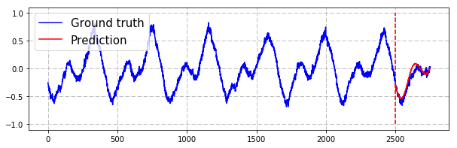
Predict
Long Short Term Memory
Fully Connected
x
x
+
x
+
x
+
x
+
x
+
x
+
x
+
+
tanh
tanh
x
x
x
x
tanh
tanh
Input
Input
Chunk

Slide 3
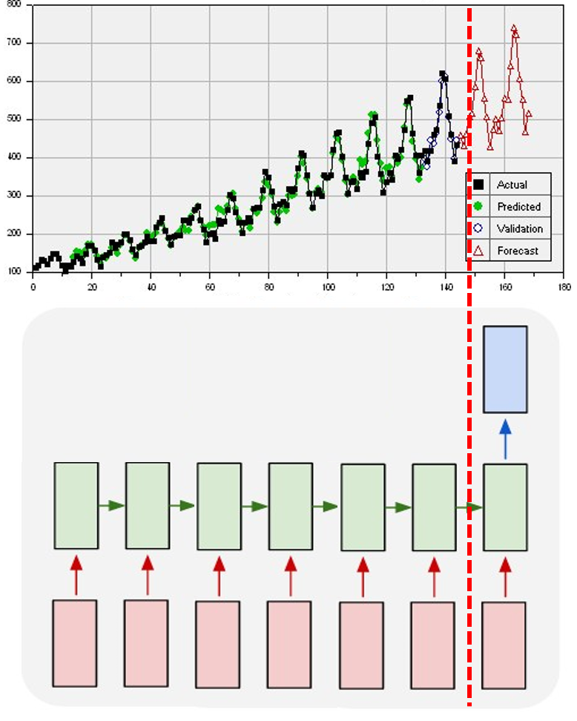
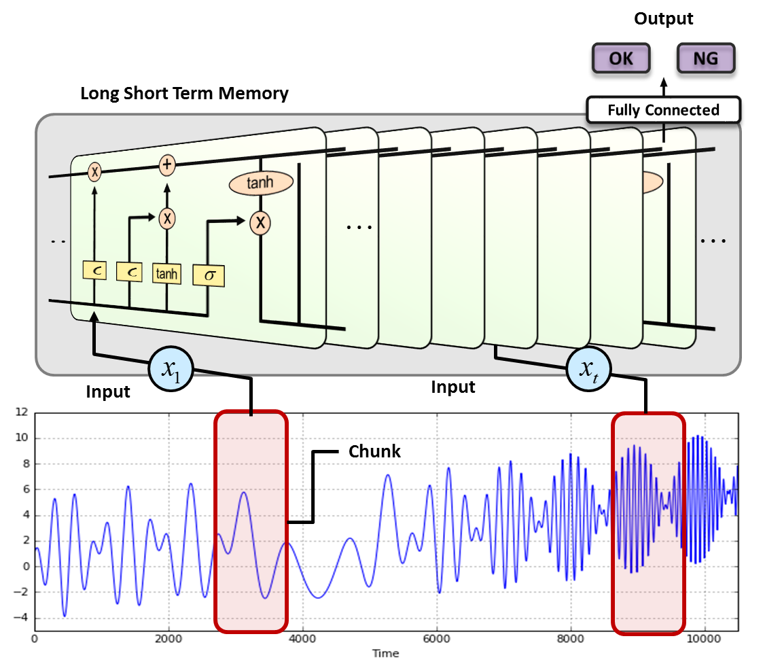
Predict
Classification

Slide 4
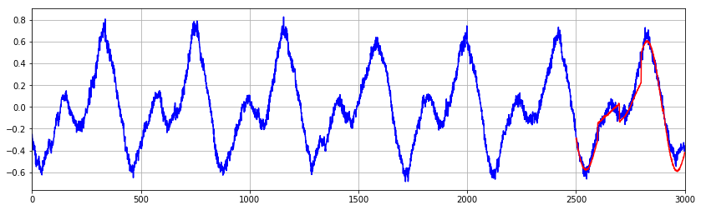
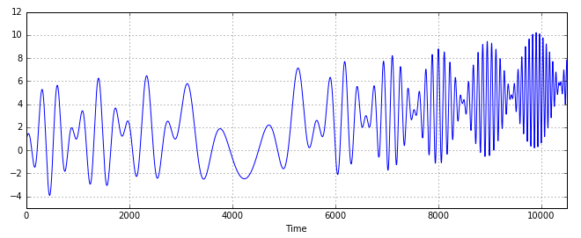
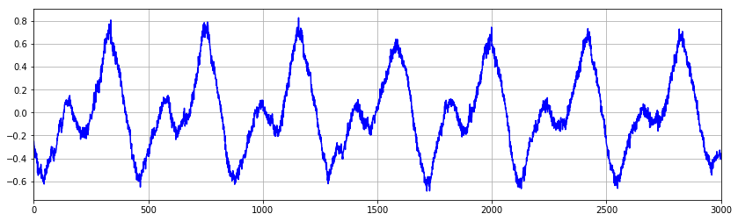
Output
OK
NG
Predict
Long Short Term Memory
Long Short Term Memory
Fully Connected
Fully Connected
x
x
+
+
+
+
+
+
+
+
+
+
+
+
+
+
+
+
x
x
x
x
x
x
x
x
x
x
x
x
x
x
tanh
tanh
tanh
tanh
x
x
x
x
x
x
x
x
tanh
tanh
tanh
tanh
Input
Input
Input
Input
Chunk
Chunk

Slide 5
Output
Predict
OK
NG
Long Short Term Memory
Long Short Term Memory
Fully Connected
Fully Connected
x
x
+
+
+
+
+
+
+
+
x
x
x
x
x
x
+
+
+
+
x
x
x
x
+
x
x
x
+
+
+
x
tanh
tanh
tanh
tanh
x
x
x
x
x
x
x
x
tanh
tanh
tanh
tanh
Input
Input
Input
Input
Chunk
Chunk
Training set
Ground truth

Slide 6
Output
layer
x
x
+
+
+
+
+
+
+
+
x
x
x
x
x
x
tanh
tanh
x
x
x
x
Long Short Term Memory
tanh
tanh
Input
Input

Slide 7
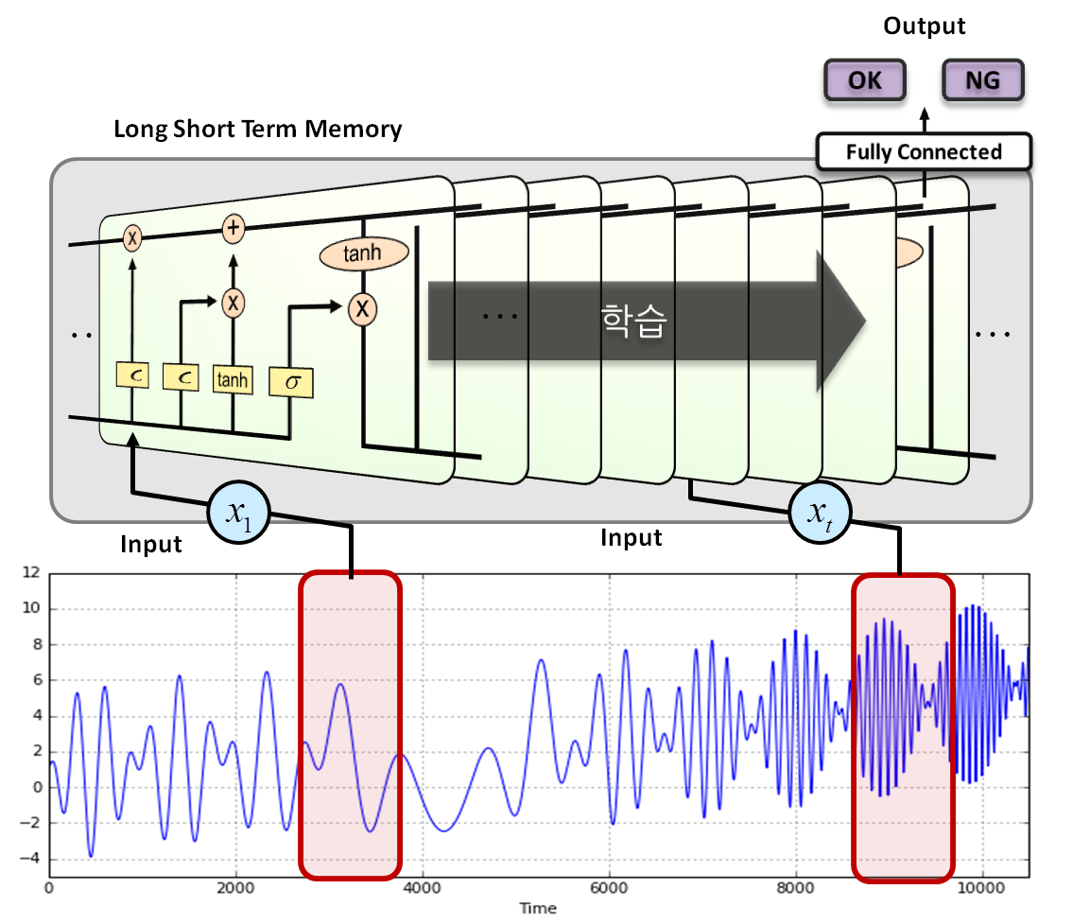

Slide 8
n_output : 100
Output
Fully connected
layer
n_hidden3 : 100
Step 1
Step 2
Step 24
Step 25
Hidden 2
Hidden 2
Hidden 2
Hidden 2
n_hidden2 : 100
n_hidden1 : 100
Hidden 1
Hidden 1
Hidden 1
Hidden 1
Input
Input
Input
Input
n_input : 100
n_input : 100
n_input : 100
n_input : 100

